Slide 1

Mix-It!
The awesome cocktail website
Notes:
alex

Slide 2

The Vision
Cocktails are cool
Automated Cocktail-Mixing
More than just a normal website
Personalization
Notes:
jenny

Slide 3
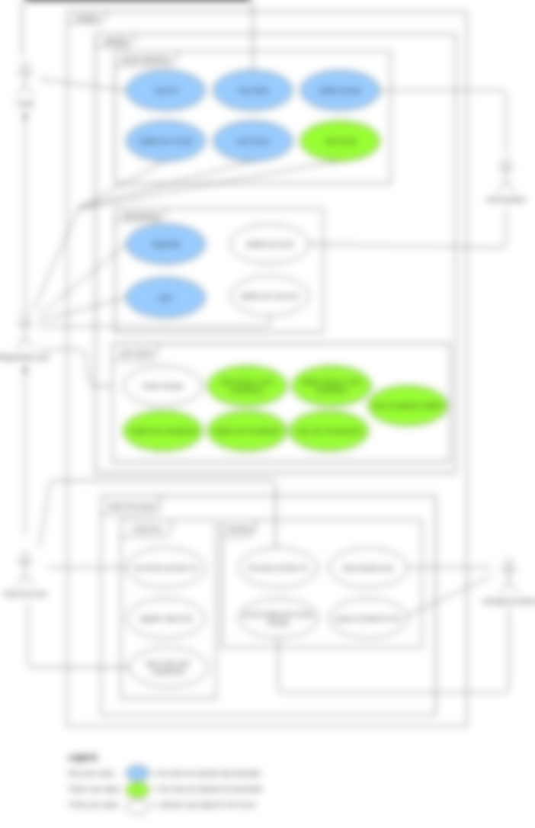
Use Cases
Notes:
Splitting into use cases helps to ensure that the requirements are captured,
Helps planning personnel resources and splits one big problem to smaller easier to solve problems
alex

Slide 4
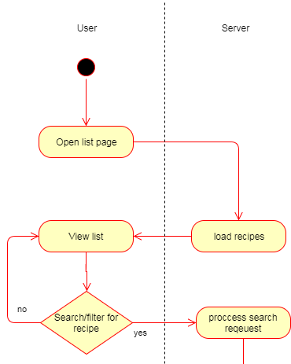
Use Cases | UML
Notes:
Visualized the process of an use case helps to write more structured code,
jenny

Slide 5
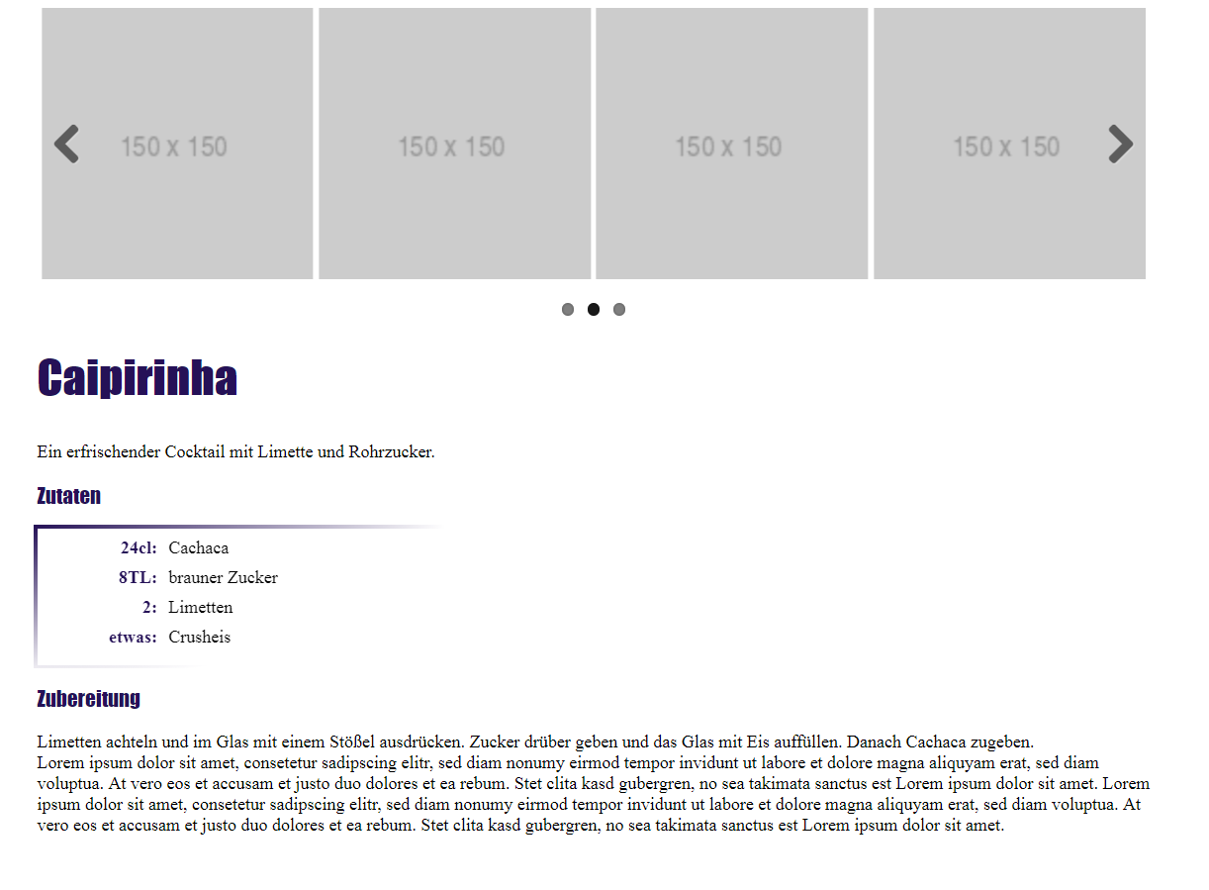
Use Cases | Mockups
Notes:
Mockups are a first draft of what the use case should look like,
alex

Slide 6
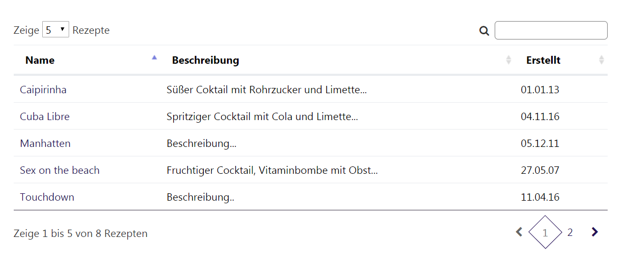
Use Cases | Mockups
Notes:
alex

Slide 7














Technology
Notes:
jenny

Slide 8
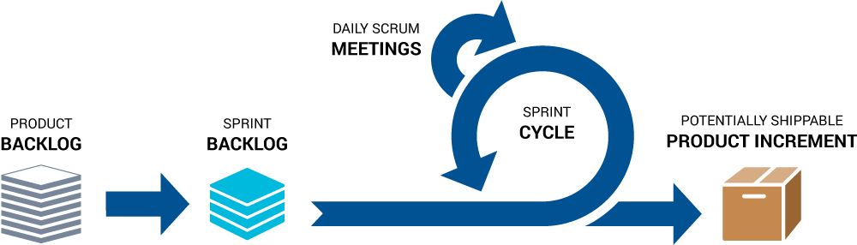
Projectmanagment: Scrumming
Belongs to agile project managment
Splits big problems to individual tasks
Notes:
Scrum ensures effective use of time and money
Large projects are divided into easily manageable sprints
Developments are coded and tested during the sprint review
Works well for fast-moving development projects
The team gets clear visibility through scrum meetings
Scrum, being agile, adopts feedback from customers and stakeholders
Short sprints enable changes based on feedback a lot more easily
The individual effort of each team member is visible during daily scrum meetings
alex

Slide 9
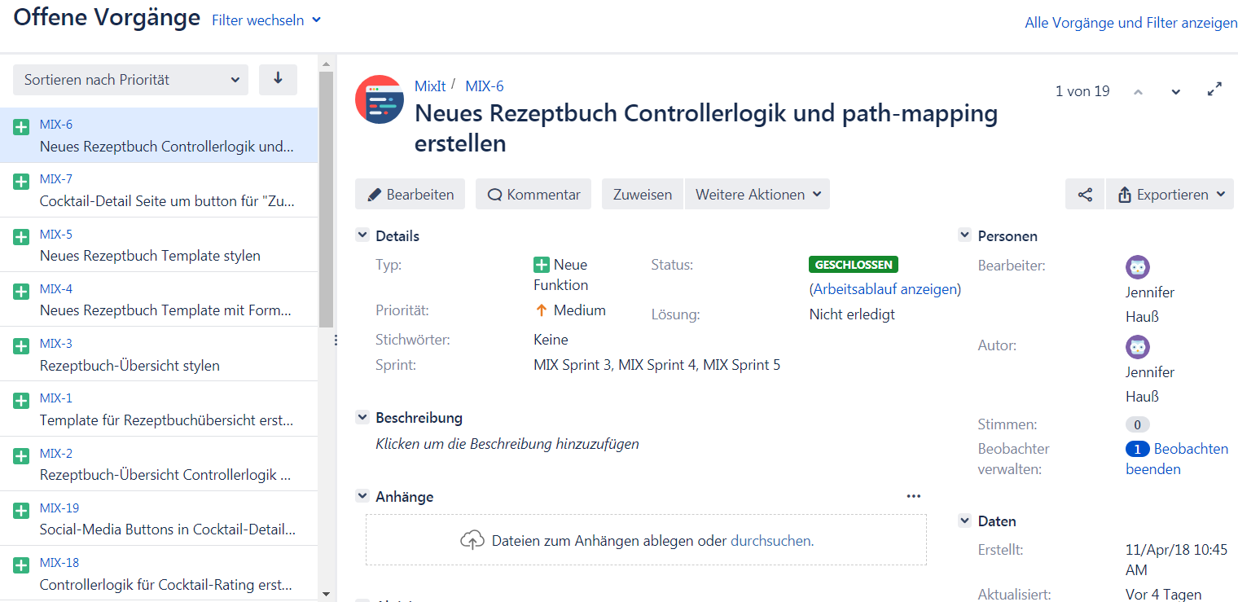
Scrumming | Jira
Notes:
jenny

Slide 10
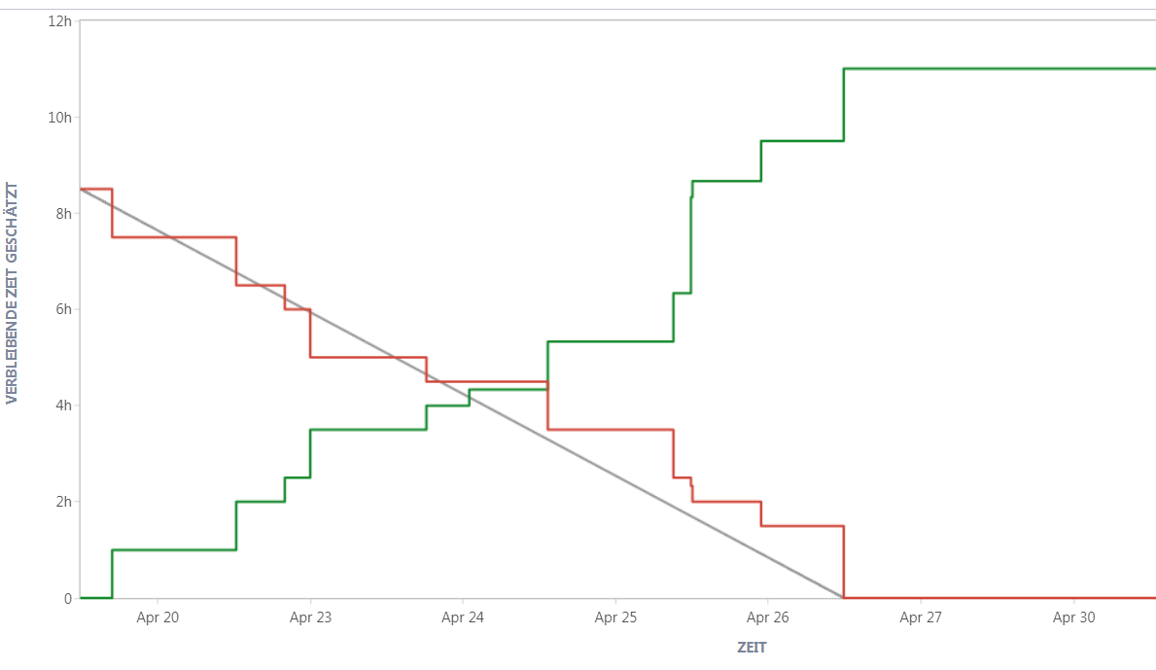
Sprints
Notes:
jenny

Slide 11
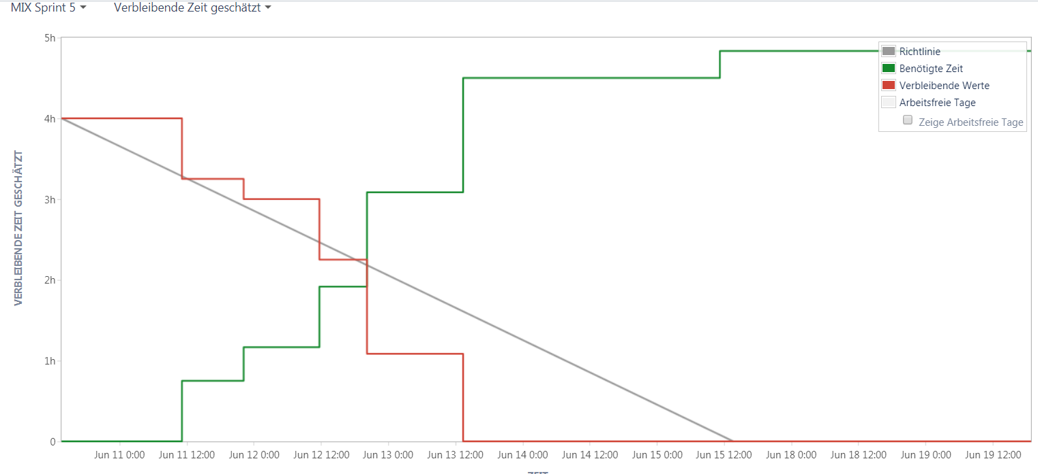
Sprints
Notes:
jenny

Slide 12
Cost Estimation (FP)
unit of measurement for the amount of business functionality
It helps to estimate the required time for program units
Can be calcuted with help of online formulars
Helps to improve time and cost planning
Notes:
alex

Slide 13
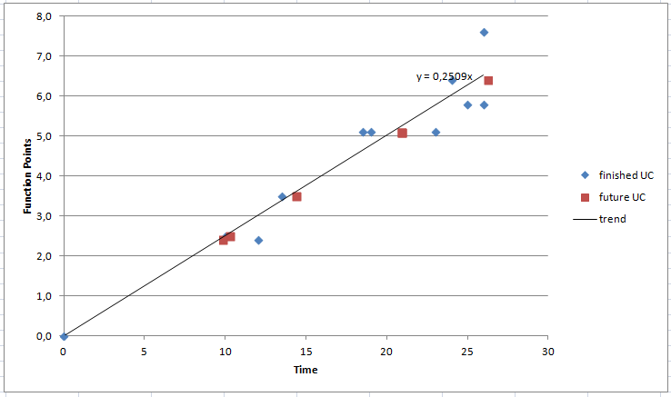
Cost Estimation (FP)
Notes:
alex

Slide 14
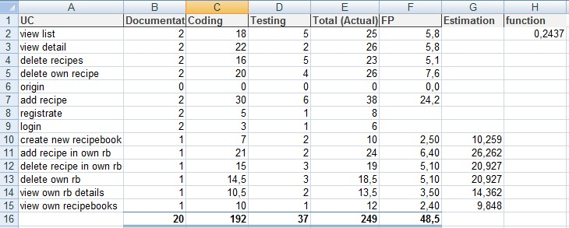
Cost Estimation (FP)
Notes:
alex

Slide 15
Risk managment
Lack of specialized skills
95%
6/10
Personnel shortfalls
90%
2/10
Inexpirienced Projectmanager
75%
2/10
Notes:
alex

Slide 16
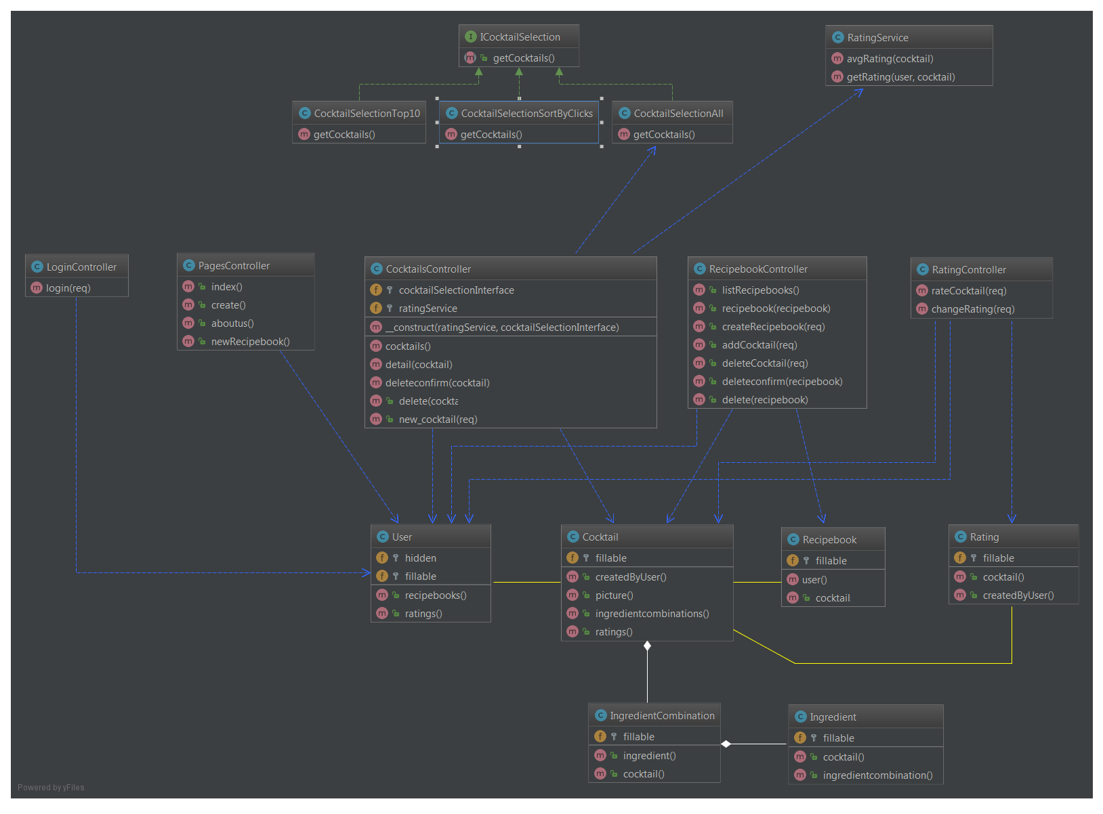
Class Diagramm
Notes:
jenny

Slide 17
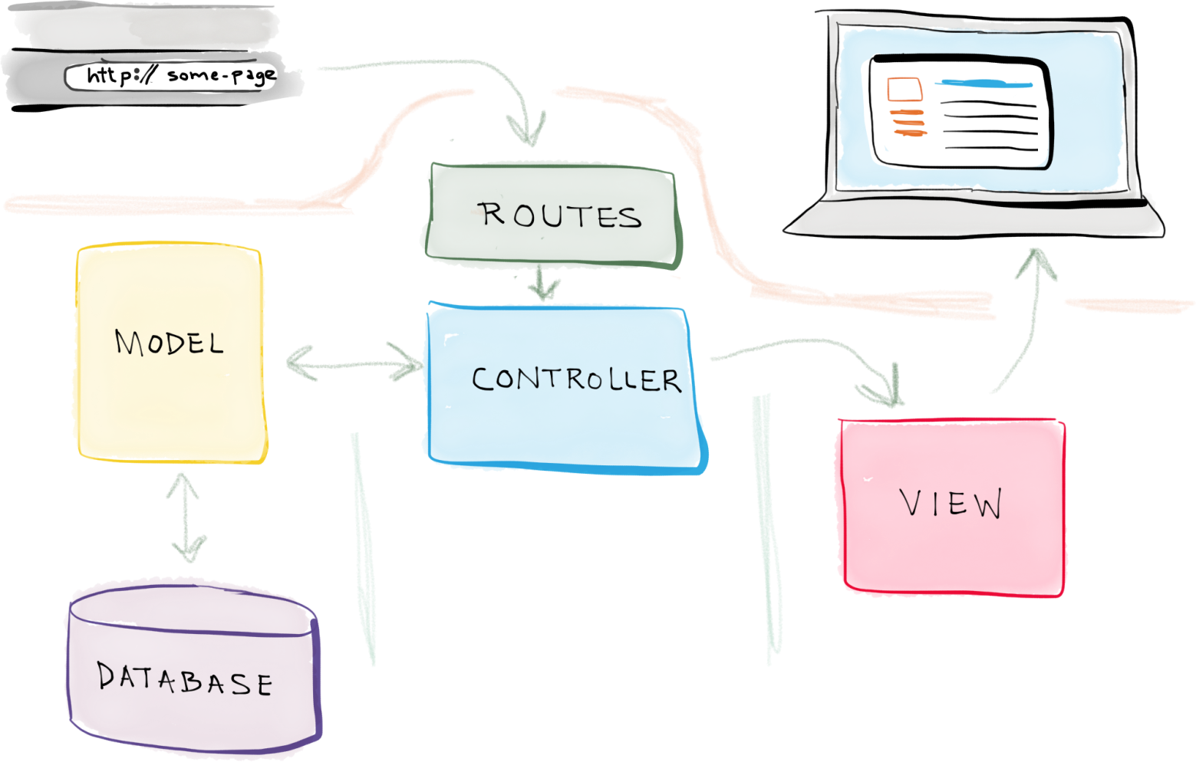
Architekture
Notes:
jenny

Slide 18
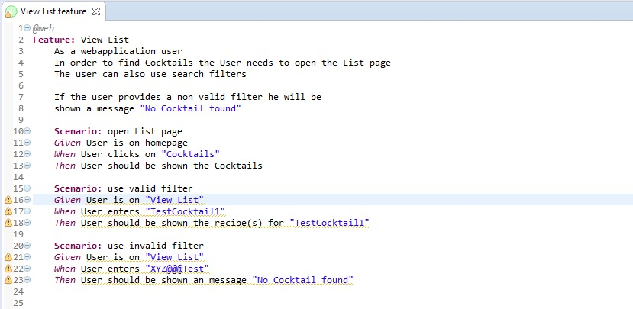
Testing | Cucumber
Notes:
alex

Slide 19
Testing | Cucumber
Notes:
TODO: bild
alex

Slide 20
Testing | Unit Tests
Tests for modules
Smallest testable part of programm
Tests logic and functionality
Doesn‘t makes sense yet
No testable logic
Notes:
alex

Slide 21
Testing | Installationtest
Has to be done by a person
Tests if the program can be installed
Successfully done by a testperson
Notes:
alex

Slide 22

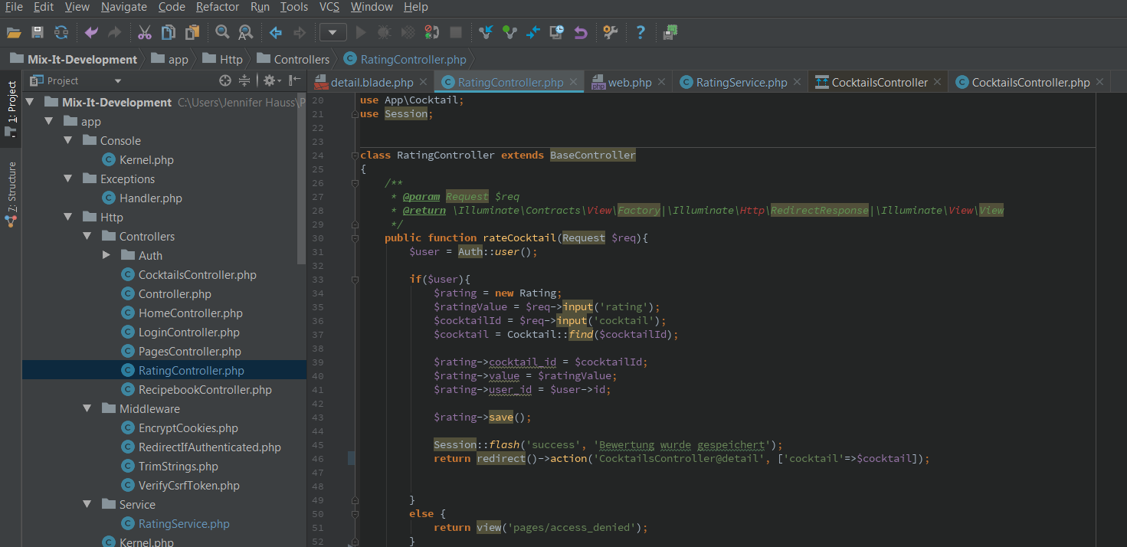
IDE & Deployment
Notes:
jenny

Slide 23
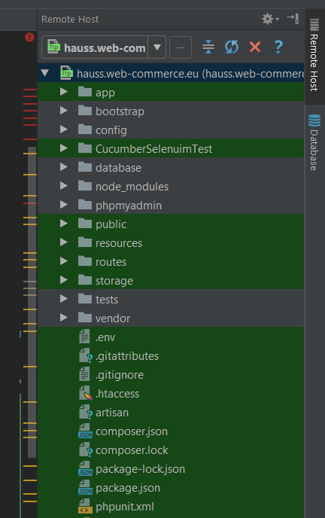

IDE & Deployment
Direct upload to server on „save“-action
Saves time for manuel deployment +
Notes:
jenny

Slide 24
Continous Integration (CI)
New program parts will be testet and merged immidiately
Continious feedback mechanism → Errors and bugs will be discovered instantly
Travis for CI
Notes:
alex

Slide 25
Metrics
measure of quantifiable or countable software characteristics
Helps getting an overview of code style
There are several metrics for:
Issues
Complex Files
Duplicated code
Code quality analysis
Security analysis
We used Sonarqube and Codacy for evaluating our metrics
By refactoring we improved our code
Notes:
alex

Slide 26
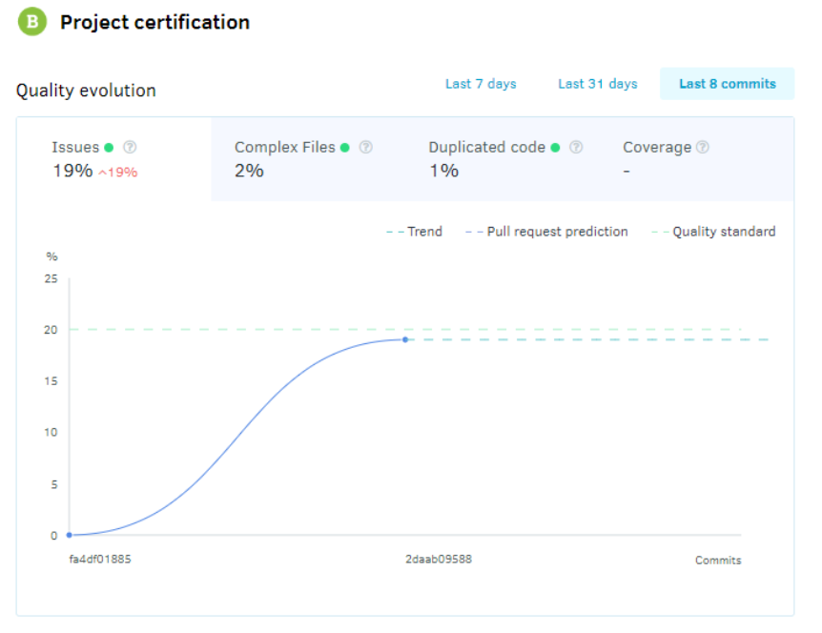
Metrics
Notes:
alex

Slide 27
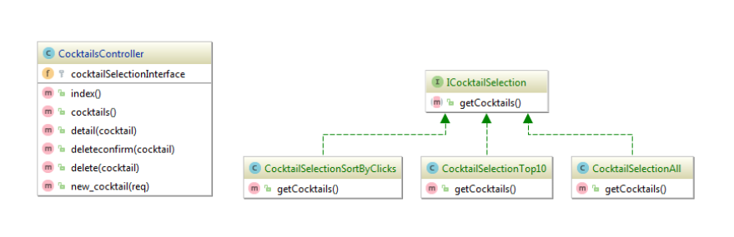
Patterns
A general, reusable solution to a commonly occurring problem
Not a finished design → a description or template for how to solve a problem
Can be used in many different situations
We used the behaviour pattern “Strategy”
Notes:
jenny

Slide 28

Demo

